Slide 1
Computer Networks _22CS008
Routing Protocols: OSPF, EIGRP, Introduction to BGP
Lecture 37-39 (Theory)
Prepared by:
Dr. Suvarna Sharma
Department of Computer Science and Engineering,
Chitkara University, Punjab

Slide 2
INDEX
Distinguish between intra and interdomain routing
Understand OSPF
Understand EIGRP
Understand BGP

Slide 3
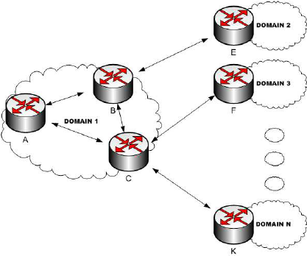
INTRA AND INTERDOMAIN ROUTING
Routing inside an autonomous system is referred to as intradomain routing. Routing between autonomous systems is referred to as interdomain routing.
Fig. 1 Intra and Inter Domain Routing
3

Slide 4
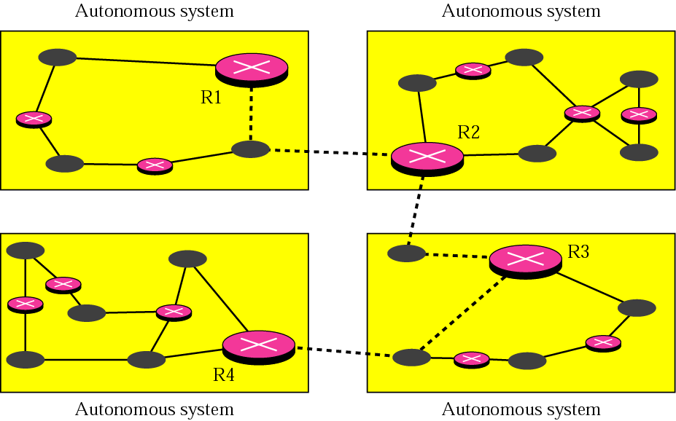
Autonomous systems
Fig. 2 Autonomous systems

Slide 5
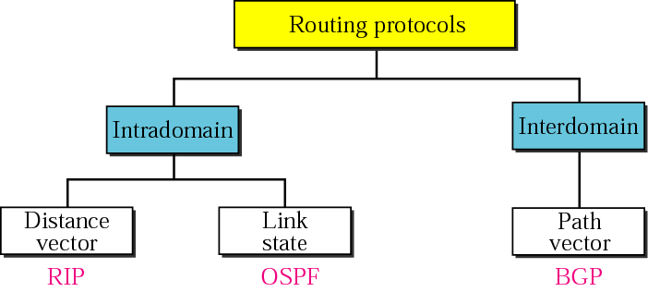
Popular Routing Protocols
Fig. 3 Routing Protocols

Slide 6
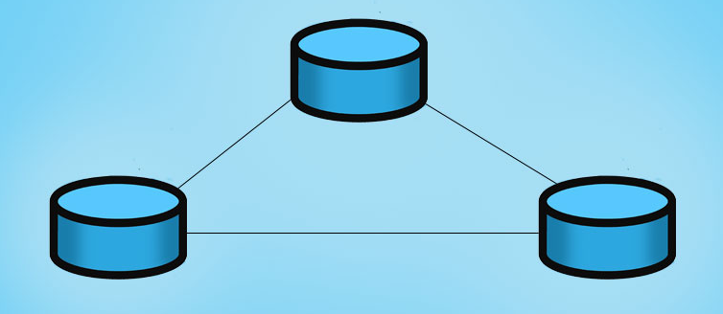
Open Shortest Path First (OSPF)
Fig. 4 Areas in an autonomous system
OSPF, which stands for Open Shortest Path First, is a routing protocol used in computer networks to find the most efficient path for routing IP (Internet Protocol) packets. OSPF is an open standard protocol, meaning it is openly published and available for implementation by networking vendors. It is commonly used in larger, enterprise-level networks where dynamic routing and efficient path selection are crucial. Its domain is also an autonomous system.
6

Slide 7
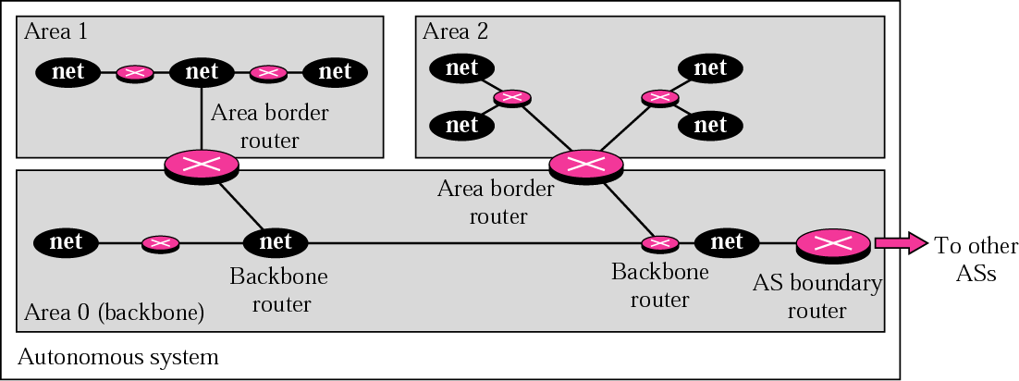
Areas in an autonomous system
Fig. 5 Areas in an autonomous system

Slide 8
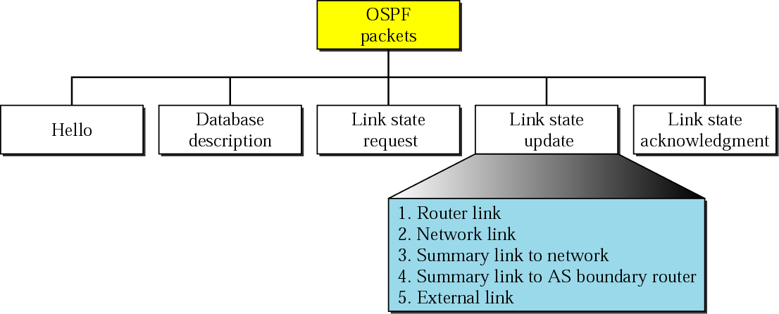
Types of OSPF packets
Fig. 7 Types of OSPF packets

Slide 9
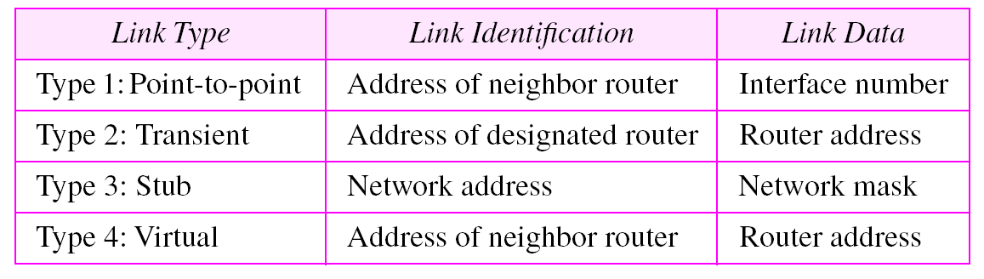
Link types, link identification, and link data

Slide 10
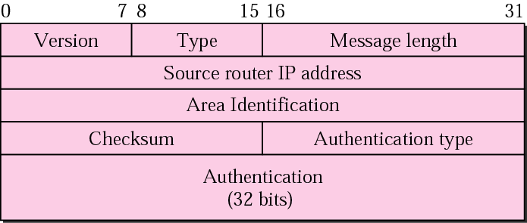
OSPF common header
Fig. 8 OSPF common header

Slide 11
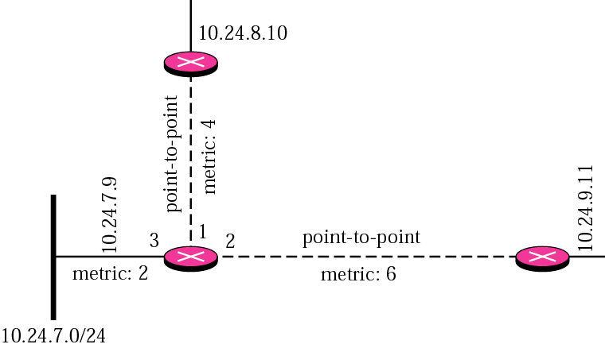
Example
Give the router link LSA sent by router 10.24.7.9 in Figure.
Fig. 9 Example

Slide 12
Solution This router has three links: two of type 1 (point-to-point) and one of type 3 (stub network). Figure 14.32 shows the router link LSA.

Slide 13
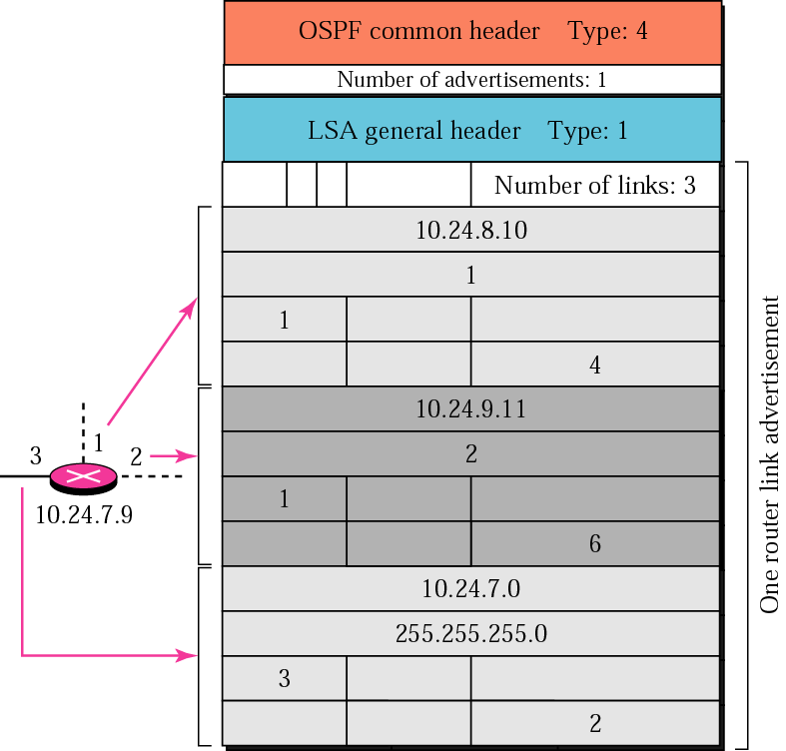
Solution to Example
Fig. 10 Solution to Example

Slide 14
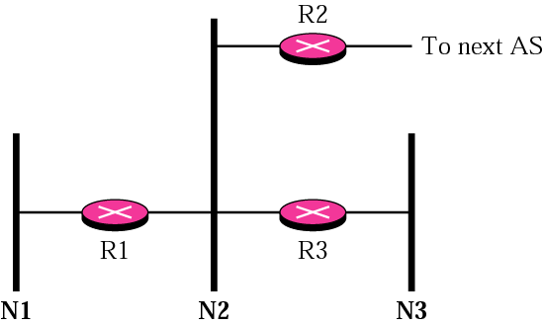
Example
In Figure, which router(s) sends out the network link LSAs?
Fig. 11 Example

Slide 15
Solution All three network must advertise network links: a. Advertisement for N1 is done by R1 because it is the only attached router and therefore the designated router.
b. Advertisement for N2 can be done by either R1, R2, or R3, depending on which one is chosen as the designated router.
c. Advertisement for N3 is done by R3 because it is the only attached router and therefore the designated router.

Slide 16
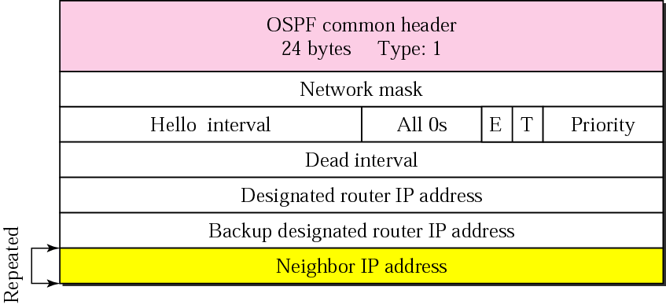
Hello packet
Fig. 12 Hello packet

Slide 17
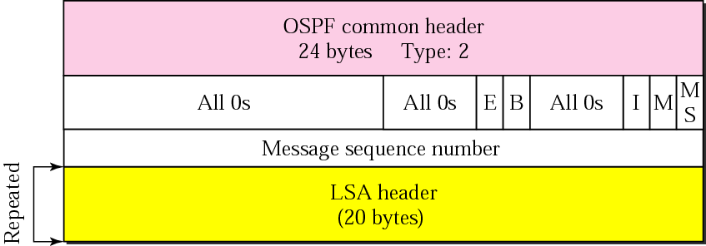
Database description packet
Fig. 13 Database description packet

Slide 18
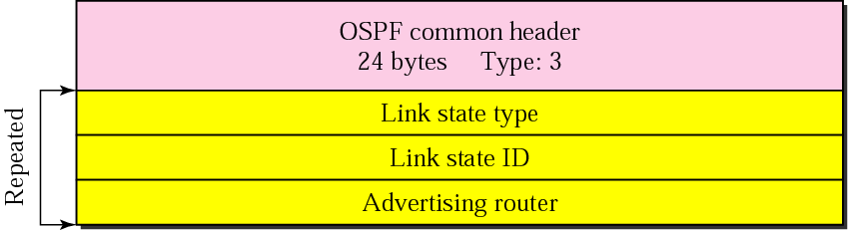
Link state request packet
Fig. 14 Link state request packet

Slide 19
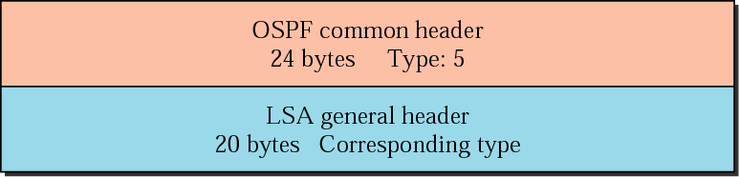
Link state acknowledgment packet
Fig. 15 Link state acknowledgment packet

Slide 20
Introduction to EIGRP
Advanced distance vector routing protocol developed by Cisco Systems.
IGRP is an older classful, distance vector routing protocol.
Includes features found in link-state routing protocols.
Suited for many different topologies and media.
Scales to include multiple topologies and can provide extremely quick convergence times with minimal network traffic.
EIGRP became a multi-vendor routing protocol.
Has a composite metric

Slide 21
Features of EIGRP
Establishing Neighbor Adjacencies .
Reliable Transport Protocol.
flexible and can be used for protocols other than those from the TCP/IP
Partial Updates.
update only includes information about the route changes, such as a new link or a link becoming unavailable.
Does not age out entries
Bounded Updates
propagation of partial updates are sent only to those routers that the changes affect.
This minimizes the bandwidth that is required to send EIGRP updates.
Equal and Unequal Cost Load Balancing

Slide 22
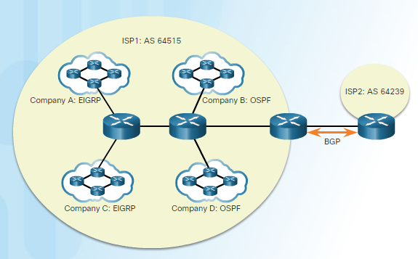
Autonomous System number
The autonomous-system argument can be assigned to any 16-bit value between the number 1 and 65,535.
All routers within the EIGRP routing domain must use the same autonomous system number
Fig. 16 Autonomous System number
22

Slide 23
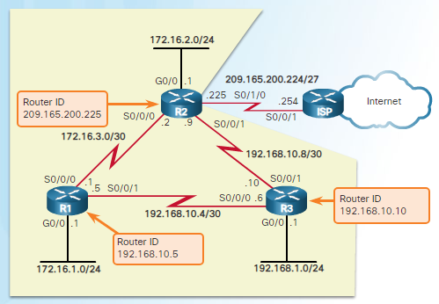
Router ID
The EIGRP router ID is used to uniquely identify each router in the EIGRP routing domain.
EIGRP for IPv4 uses the 32-bit router ID to identify the originating router for redistribution of external routes.
Fig. 17 Router ID
23

Slide 24
Metric
Bandwidth
Bandwidth is the capacity of a wired or wireless network link to transmit the maximum amount of data from one point to another in a given amount of time.
Bandwidth is the lowest configured bandwidth on any interface on the route.
You should always configure a bandwidth value on an interface when using EIGRP, otherwise a default is used.
Delay: is how long it takes for a bit to travel across the network from one node to another.
It includes the following: (Processing– Queuing-Transmission –Propagation)
Delay is calculated as the sum of delays from source to destination in units of 10 microseconds.
24

Slide 25
EIGRP metric
Bandwidth and delay are used by default.
Load and reliability can be used too.
metric =
[K1*bandwidth + K2*bandwidth + K3*delay] * K5
256 - load
Reliability + K4
If K1 = K3 = 1 and K2 = K4 = K5 = 0
Metric =
(bandwidth + delay)
25

Slide 26
Bandwidth
The actual bandwidth is NOT measured.
Most serial interfaces use the default T1 bandwidth value of 1544 Kbps (1.544 Mbps).
If this is not close to the actual bandwidth then change the bandwidth setting.
Router(config-if)#bandwidth 64
This does not change the bandwidth of the link.
26

Slide 27
Using bandwidth
Take the lowest bandwidth value in the path.
Calculate (10,000,000/bandwidth) * 256
This is the bandwidth part of the metric.
Just to confuse you, this is also called “bandwidth” in the formula: metric = “bandwidth” + delay
27

Slide 28
Delay
Delay is a measure of the time it takes for a packet to traverse a route.
Delay is not measured dynamically.
Default values are used, e.g.
Serial interfaces 20,000 microseconds
Fast Ethernet interfaces 100 microseconds
The delay value can be changed.
28

Slide 29
Using delay
Find the delay value on every outgoing interface along the path.
Add up all these values.
Delay metric = (sum of delay/10)* 256
Just to confuse you, this is also called “delay” in the formula: metric = “bandwidth” + “delay”
29

Slide 30
Example step 1
Metric to this network?
BW 1,024 Kbps delay 20000
BW 100,000 Kbps delay 100
Fig. 18 Example step 1
Bandwidth metric = (10,000,000/1024)*256
Round 10,000,000/1024 to a whole number before multiplying by 256
Bandwidth metric = 2,499,840.
30

Slide 31
Example step 2
Metric to this network?
BW 1,024 Kbps delay 20000
BW 100,000 Kbps delay 100
Fig. 19 Example step 2
Delay metric = (sum of delay/10)* 256
= (20100/10)*256
= 514560
31

Slide 32
Example step 3
Metric to this network?
BW 1,024 Kbps delay 20000
BW 100,000 Kbps delay 100
Fig. 20 Example step 3
Bandwidth metric = 2,499,840
Delay metric = 514560
Bandwidth + delay = 3014400
This is the metric calculated by the router on the left.
32

Slide 33
Reliability and Load
Reliability is measured dynamically. It measures the frequency of errors and the probability that the link will fail.
255 is totally reliable, 0 is totally unreliable.
Not a default EIGRP metric.
Load is measured dynamically. It shows the amount of traffic using the link.
1/255 is minimal load. 255/255 is fully saturated.
Both transmit and receive load are measured.
Not a default EIGRP metric
33

Slide 34
Network layer protocols
EIGRP can support more than one network layer protocol, e.g. IP, IPX, Appletalk.
It has protocol dependent modules to support the different network layer protocols.
It keeps separate routing tables, neighbor tables and topology tables for the different network layer protocols.
The main EIGRP software is independent of the network layer protocol.
34

Slide 35
Reliable Transport Protocol
RTP is used instead of TCP and UDP.
It can provide reliability like TCP by means of acknowledgements.
It can send some packets unreliably like UDP.
TCP and UDP are not used because that would tie EIGRP to the TCP/IP suite, and it was designed to be independent.
35

Slide 36
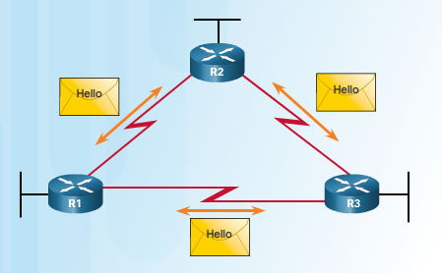
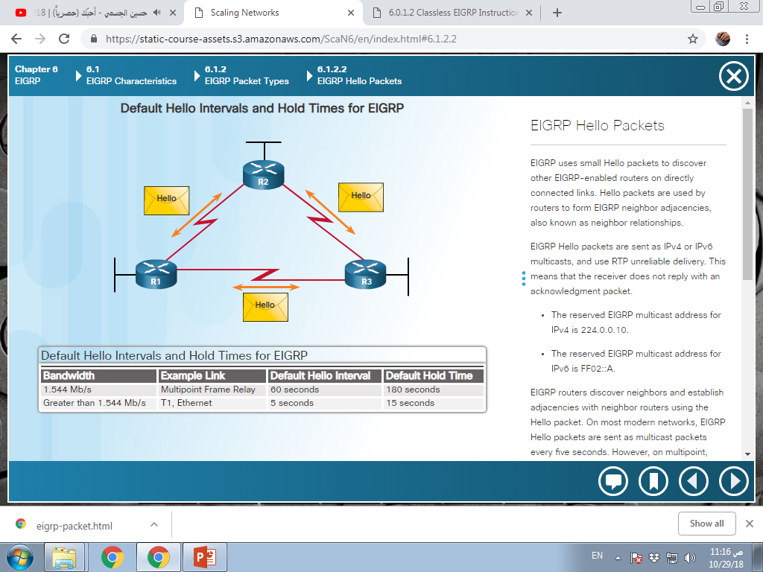
EIGRP Packet Types
Hello packets - Used for neighbor discovery and to maintain neighbor adjacencies.
Sent with unreliable delivery
Multicast
Holdtime=3× helloInterval
Fig. 21 EIGRP Packet Types
36

Slide 37
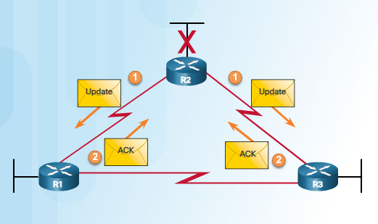
EIGRP Packet Types
Update packets - Propagates routing information to EIGRP neighbors. (partial update, bounded update)
Sent with reliable delivery
Unicast or multicast
Acknowledgment packets
Sent with unreliable delivery
Unicast
Fig. 22 EIGRP Packet Types
37

Slide 38
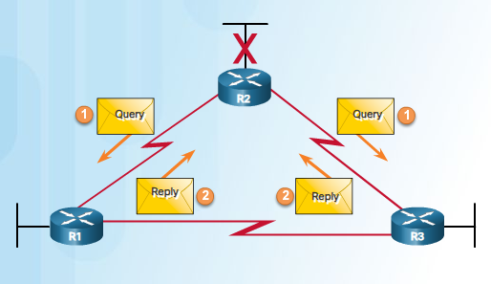
EIGRP Packet Types
Query packets -
Sent with reliable delivery
Unicast or multicast
Reply packets - Sent in response to an EIGRP query.
Sent with reliable delivery
Unicast
Fig. 23 EIGRP Packet Types
38

Slide 39
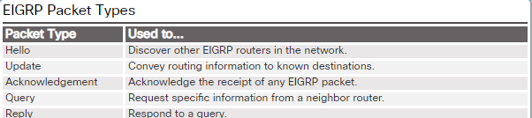
EIGRP Packet Types
39

Slide 40
Introduction to BGP
Border Gateway Protocol (BGP) is an interdomain routing protocol using path vector routing. It first appeared in 1989 and has gone through four versions.
BGP supports classless addressing and CIDR.
BGP uses the services of TCP on port 179.

Slide 41
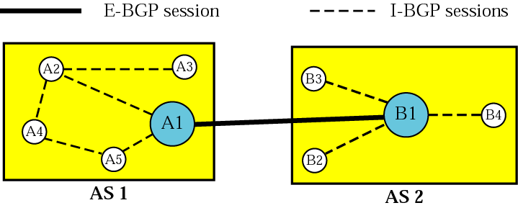
Internal and external BGP sessions
Fig. 24 Internal and external BGP sessions

Slide 42
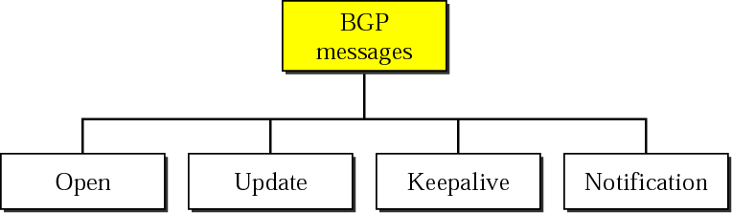
Types of BGP messages
Fig. 25 Types of BGP messages

Slide 43
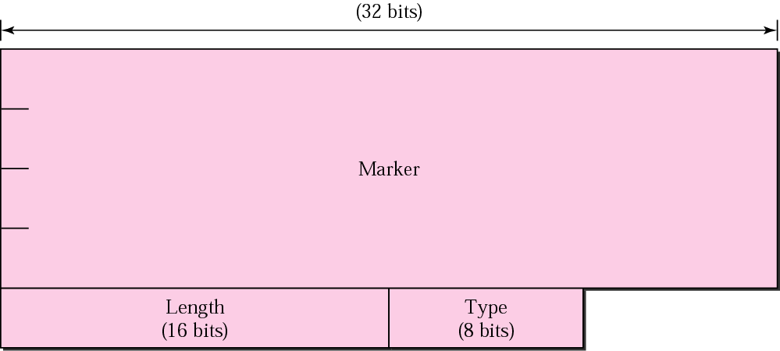
BGP packet header
Fig. 26 BGP packet header

Slide 44
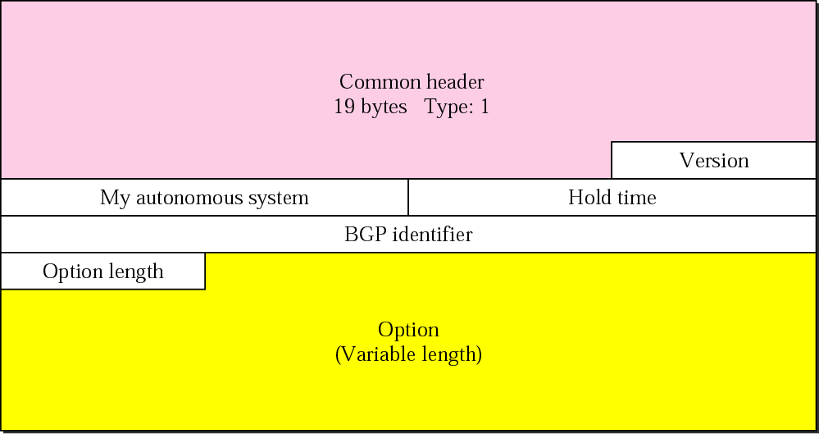
Open message
Fig. 27 Open message

Slide 45
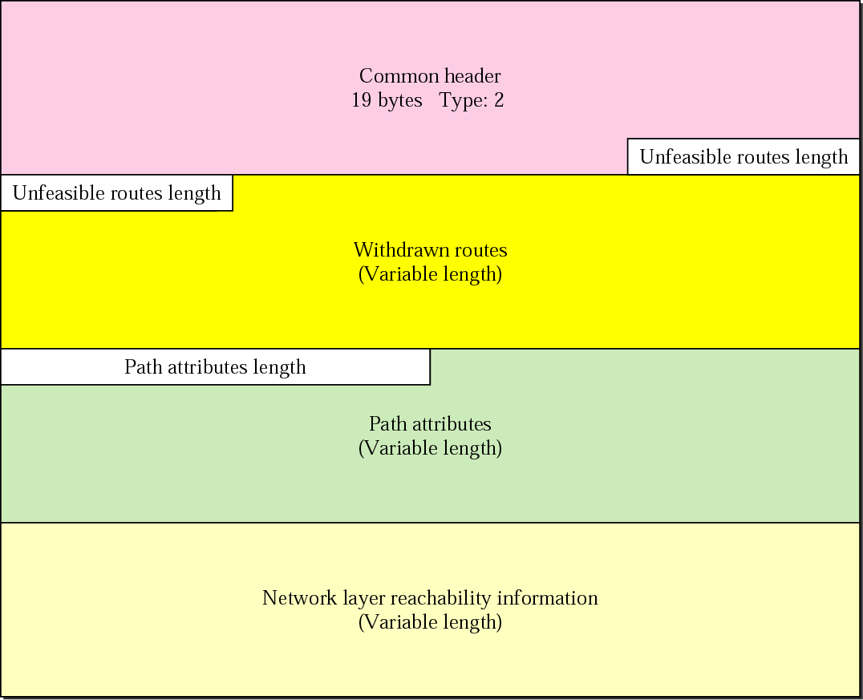
Update message
Fig. 28 Update message

Slide 46
Practice Questions
Alternate and adaptive routing algorithm belongs to ……….
static routing
permanent routing
standard routing
dynamic routing
………. protocol is a popular example of a link-state routing protocol.
SPF
BGP
RIP
OSPF
EIGRP metric is ________ a) K-values b) Bandwidth only c) Hop Count d) Delay only
EIGRP sends a hello message after every ___________ seconds.
5 seconds (LAN), 60 seconds (WAN)
5 seconds (LAN), 5 seconds (WAN)
15s
180s

Slide 47
Practice Questions
Which of the following is/are the benefits provided by EIGRP?
i) Faster convergence
ii) partial routing updates
iii) High bandwidth utilization
iv) Route summarization
A. i, iii and iv only
B. i, ii and iii only
C. ii, iii and iv only
D. i, ii and iv only
In OSPF, a ………. link is a network is connected to only one router.
A. point-to-point
B. transient
C. stub
D. multipointstatic routing
In OSPF, when the link between two routers is broken, the administration may create a …….. link between them using a longer path that probably goes through several routers.
A. point-to-point
B. transient
C. stub
D. multipoint

Slide 48
Practice Questions
Which command can you enter to verify that a BGP connection to a remote device is established?
A. Show ip bgp summary
B. Show ip community-list
C. Show ip bgp paths
D. Show ip route
Which two components are used to identify a neighbor in a BGP configuration? (Choose two)
Autonomous system number
Version number
Router ID
Subnet mask
IP address
A. i and ii
B. i and v
C. ii and iv
D. iii and v

